Slide 1
PRC-1
Batch-14
Vehicle Intrusion Detection using open-cv (python 3.6x) and deep learning
Karthik Vakkalagadda(15L31A05J7)
Ravindra Saragadam(15L31A05H0)
Kavya Manubarthi(16L35A0505)
Balaji Sundarapu(15L31A05I4)
Guide:Sekhar.ch
DEPARTMENT OF CSE

Slide 2
Problems:
PRC-1
What it is all about
Vehicle intrusion detection also know as VID
It is an enhancement for the existing security system
Developed on basis of conventional computer vision and deep learning algorithms
It has the capability of identifying the unauthorized vehicles which trespass in secret areas
DEPARTMENT OF CSE

Slide 3
Solution using computer vision
Computer vision provides huge advantage for Vehicles Intrusion detection by emulating the striking perceptual capability of human eye.
Through a Security video capturing device we can monitor the inward and outward traffic.
We can break down a video into set of frames and then we can perform our computation on frames from the input video

Slide 4
Usage
PRC-1
Military base
Security check depo’s
Nuclear research bases
Restricted zones…etc
DEPARTMENT OF CSE

Slide 5
Requirements
PRC-1
Python 3.6x
Openpyxl
Pymysql
SMTP python
OpenCV
Tensor flow
Multithreading
Deep learning algorithms
Any Video Capturing device
DEPARTMENT OF CSE

Slide 6
What is an openCv?
It is an open source computer vision library
Computer vision is concerned with the automatic
Extraction, analysis and understanding of useful
information from a single image or a sequence of images.
It involves the development of a theoretical and algorithmic basis
to achieve automatic visual understanding

Slide 7
What is Pymysql
Pymysql is database framework which can act as a middle ware between python and it’s associated database
It can perform all the create.read.update.delete operations required for an application on the database with simpler syntax

Slide 8
What is OpenPyxl
Open pyxl is open source python framework
which can be used to read the pre prepared data from excel sheet which consists structured and consisted data into the spool memory of python
It allows to perform all the crud operations on excel sheets

Slide 9
How we develop?
Development of this project is fragmented to
four different phases
Those are:
Database creation with users data
Analysis using deep learning on streaming video
Query processing verifying the user details
Output generation to security in form of a mail

Slide 10
Stage -1: creating authenticated vehicles database
In this stage we manual collect all the authenticated vehicles registration numbers
The collected data are stored in comma separated files
Stored files then are send to OpenPyXl and Pymysql to import the data into the database

Slide 11
Stage-2: analysis using opencv middleware
This stage is implemented to support two different modes
Online (with live camera)
Offline (recorded video)
Deep learning algorithms are implemented in python to support both the functionalities

Slide 12
Stage-3:Query processing using multithreading
Once the analysis is done a thread will be created to the frame of particular time stamp
Created thread is responsible for security check
If intrusion is detected then the thread invokes a smtp request to security system
In case of no intrusion then the thread will automatically joins to main thread

Slide 13
Stage-4: Output generation for intrusion on smtp
A snapshot of the vehicle along with its registered number will be emailed to the security department
There will be no interruption to the computer vision during this time interval

Slide 14
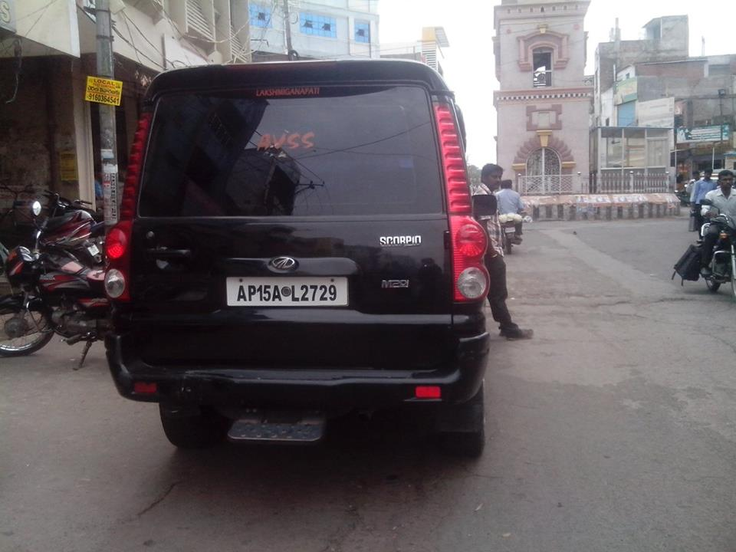
Sample demonstration on authenticated user
Graphic abstraction
Registered person id | Vehicle number
11113 | AP 15 AL 2729
11114 | AP 31 BG 7000
…….. | …….
Authenticated user

Slide 15
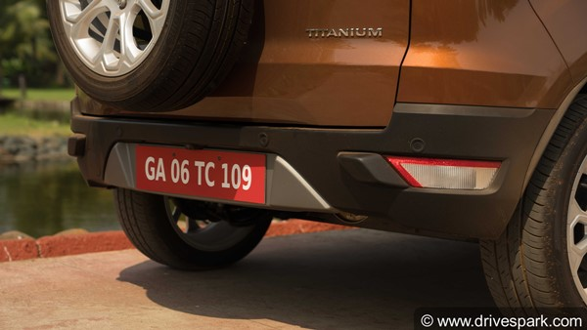
Sample demonstration on intruded user
Registered person id | Vehicle number
11113 | AP 15 AL 2729
11114 | AP 31 BG 7000
…….. | …….
Intrusion detected

Slide 16
Sample demonstration on intruded user part-2
smtp
Security alert

Slide 17
Mapping of PO’s
PRC-1
PROGRAM OUTCOMES | MAPPING
PO 1(Engineering Knowledge) | 1
PO 2(Problem Analysis) | 1
PO 3(Design / Development of solutions) | 1
PO 4(Conduct investigations of complex problems) | 0
PO 5(Modern tool usage) | 0
PO 6(The engineer and society) | 0
PO 7(Environment and sustainability) | 0
PO 8(Ethics) | 1
PO 9(Individual and team work) | 1
PO 10(Communication) | 0
PO 11(Project Management and finance) | 0
PO 12(Life-Long learning) | 1
DEPARTMENT OF CSE

Slide 18
Time Line
PRC-1
Time Line of project with stages
Dec : Project Initiation and Planning
Jan : Project Execution
Feb : Project Testing
Mar : Project Documentation
Dead line by the end of semester

Slide 19
Thank you

